Slide 1
Real Time communications

Slide 2
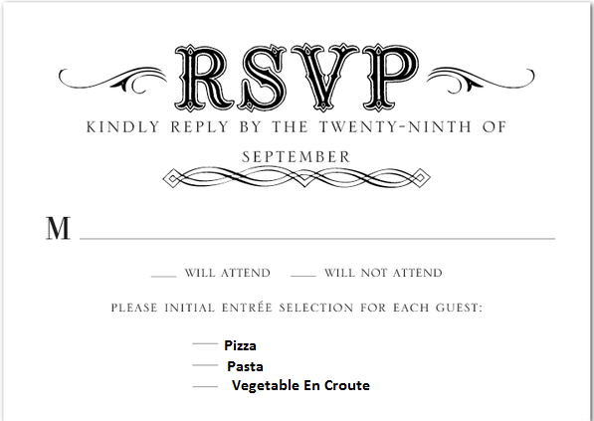
Reservation Protocol RSVP

Slide 3
RSVP
In the Real time communication requirements like VOIP, there is another alternative to ensure that we get the need to needed resource in the path. This is method is called RSVP or Reservation Protocol.
RSVP is Transport Layer protocol which reserves resource across a network.
RSVP can be used by either host or routers to request or deliver specific levels of quality of service (QoS) for application data streams or flows.
RSVP defines how applications place reservations and how they can relinquish the reserved resources once the need for them has ended.
RSVP operation will generally result in reservation of resource in each node along a path.
A VOIP call is established only if the needed resource are reserved all along the path.

Slide 4
RSVP
RSVP is the Internet Engineering Task Force (IETF) Internet Standard (RFC 2205) protocol for allowing an application to dynamically reserve network bandwidth.
RSVP enables applications to request a specific QoS for a data flow.
RSVP is the only standard signaling protocol designed to guarantee network bandwidth from end to end for IP networks.
Hosts and routers use RSVP to deliver QoS requests to the routers along the paths of the data stream and to maintain router and host state to provide the requested service, usually bandwidth and latency.
RSVP uses a mean data rate, the largest amount of data the router will keep in queue, and minimum QoS to determine bandwidth reservation.
RSVP uses WFQ to allocate buffer space and schedule packets, and to guarantee bandwidth for reserved flows.
WFQ or Weighted Random Early Detection (WRED) acts as the preparer for RSVP, setting up the packet classification and scheduling required for the reserved flows.

Slide 5
Key Concepts
RSVP is based on three concepts :
Flow Spec
Filter Spec
Messages
A flow is identified by
Destination address,
Protocol identifier,
Optionally, the destination port.
This QoS specific information is called a flowspec and RSVP passes the flowspec from the application to the hosts and routers along the path. Those systems then analyse the flowspec to accept and reserve the resources. A flowspec consists of:
Service class
Reservation spec - defines the QoS
Traffic spec - describes the data flow

Slide 6
Filterspec
The filterspec defines the set of packets that shall be affected by a flowspec (i.e. the data packets to receive the QoS defined by the flowspec). A filterspec typically selects a subset of all the packets processed by a node.
Messages
Path messages (path)
The path message is sent from the sender host along the data path and stores the path state in each node along the path.
Reservation messages (resv)
The resv message is sent from the receiver to the sender host along the reverse data path. At each node the IP destination address of the resv message will change to the address of the next node on the reverse path and the IP source address to the address of the previous node address on the reverse path.

Slide 7
Operation of RSVP
An RSVP host that needs to send a data flow with specific QoS will transmit an RSVP path message every 30 seconds that will travel along the unicast or multicast routes pre-established by the working routing protocol.
If the path message arrives at a router that does not understand RSVP, that router forwards the message without interpreting the contents of the message and will not reserve resources for the flow.
Those who want to listen to them send a corresponding resv (short for "Reserve") message which then traces the path backwards to the sender. The resv message contains the flow specs. When a router receives the RSVP resv message it will:
1. Make a reservation based on the request parameters. For this the admission control and policy control process the request parameters and can either instruct the packet classifier to correctly handle the selected subset of data packets or negotiate with the upper layer how the packet handling should be performed. If they cannot support the reservation being requested, they send a reject message to let the listener know about it.
2. Forward the request upstream (in the direction of the sender). At each node the resv message flowspec can be modified by a forwarding node (e.g. in the case of a multicast flow reservation the reservations requests can be merged).
3. The routers then store the nature of the flow, and also police it. This is all done in soft state,

Slide 8
Real Time Protocol

Slide 9
WHY CAN’T WE USE TCP/IP
TCP is a reliable protocol
Uses error control mechanisms like retransmission when an error occurs,
Retransmission delay is a real problem TCP when used in Real Time communication
The retransmission causes end-to-end latency
Retransmissions are needed for http, FTP, telnet (which need error free communication)
During Video Telephony large amount of data is transmitted into the network, which will result in network congestion.
When there is network congestion, TCP will try to control the data transmission rate to reduce the congestion, this will results in additional end to end day and Real time communication experience is lost

Slide 10
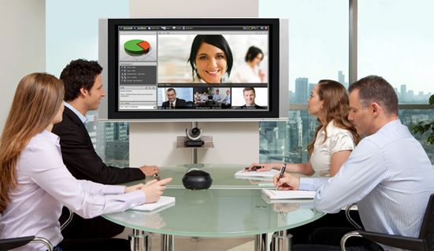
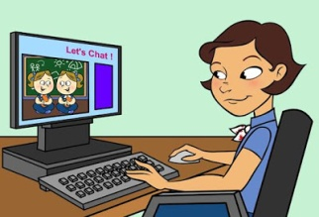
Real time protocol
Real time protocol is designed to transmit, data in Real time
It is build over UDP,
Since UDP is not connection oriented and does not provide reliability RTP address those aspects without compromising on the real time properties of the data stream
It can scale from single one to one audio/video call to multiparty conferencing calls.
RTP uses separate streams for audio and video, which are called media streams
Each media stream uses a pair to ports, one for sending media (audio/video) and other for control packets. The IP address and port numbers to which media and control information has to be transmitted need to be know prior to the call.
Audio
Video
RTP
RTCP

Slide 11
During call or conference each chunk of audio video data from each participant is copied into a packet format, called RTP packet and transmitted over a UDP socket connection to the other side.
The second port through which control data is exchanged uses another protocol called RTCP ( Real Time Control Protocol), which also uses UDP ports. This contains info on: Sender reports (SR)
Receiver reports (RR)
Information on packet losses, delay and delay jitter.
This information is used to implement a TCP like flow control mechanism upon UDP at the application level using adaptive encodings

Slide 12
RTP
Since UDP cannot guarantee reliability and data packets arrive in the original order
RTP create its own time stamping and sequencing mechanism to ensure ordering. For this RTP uses the following headers.
No | Header Name | Description
1 | Payload Type | Media type and encoder name
2 | Timestamp | Most important field in RTP, records the time at which the first octet is sampled
3 | Sequence Number | This a number which is incremented each time when a packet is send. This field is used to reconstruct the sequence, this is needed because at time during video encoding, all the packets in video stream may be same timestamp
4 | Synchronization Source ID | Identifies the source of the audio/video data , this is needed when there are multiple microphones/camera and they need to synchronized
5 | CSRC ID | Contributing Source ID

Slide 13

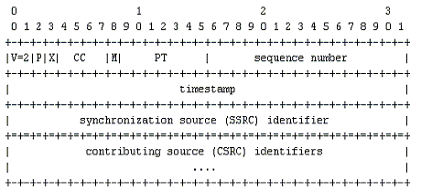

Slide 14
RTP Header
Version (V): 2 bits This field identifies the version of RTP. The version is 2 upto RFC 1889.
padding (P): 1 bit If the padding bit is set, the packet contains one or more additional padding octets at the end which are not part of the payload. The last octet of the padding contains a count of how many padding octets should be ignored. Padding may be needed by some encryption algorithms with fixed block sizes or for carrying several RTP packets in a lower-layer protocol data unit.
Extension (X): 1 bit If the extension bit is set, the fixed header is followed by exactly one header extension.
CSRC count (CC): 4 bits The CSRC count contains the number of CSRC identifiers that follow the fixed header.
Marker (M): 1 bit Marker bit is used by specific applications to serve a purpose Application Level Framing.
RTP is a protocol framework that is deliberately not complete. It is not steadfast in certain structures and can be modified in a way to suit a specific application. RTP is intended to be malleable to provide adequate functionality. This characteristic is known as Application Level Framing and is an important aspect of RTP.

Slide 15
Payload type (PT): 7 bits This field identifies the format (e.g. encoding) of the RTP payload and determines its interpretation by the application. This field is not intended for multiplexing separate media.
Sequence number: 16 bits The sequence number increments by one for each RTP data packet sent, and may be used by the receiver to detect packet loss and to restore packet sequence. The initial value of the sequence number is random (unpredictable).
Timestamp: 32 bits The timestamp reflects the sampling instant of the first octet in the RTP data packet. The sampling instant must be derived from a clock that increments monotonically and linearly in time to allow synchronization and jitter calculations.
SSRC: 32 bits The SSRC field identifies the synchronization source. This identifier is chosen randomly, with the intent that no two synchronization sources within the same RTP session will have the same SSRC identifier.
CSRC list: 0 to 15 items, 32 bits each The CSRC list identifies the contributing sources for the payload contained in this packet. The number of identifiers is given by the CC field. If there are more than 15 contributing sources, only 15 may be identified. CSRC identifiers are inserted by mixers, using the SSRC identifiers of contributing sources.

Slide 16
How does RTP synchronizes packet
Synchronization Source (SSRC)
The receiver may be receiving data from several sources. So for proper arrangement it needs to identify the source of individual packets which is possible from the SSRC field.
Sequence Number
It is not enough to identify the source, the order is important too. The sequence number increments by one for each RTP data packet sent, and may be used by the receiver to detect packet loss and to restore packet sequence. The loss or out-of-order delivery occurs due network problems.
Timestamp
For media delivery not just the order of the packets but also the sampling instant of individual packets are important. Please go through the following paragraph carefully.
Several consecutive RTP packets may have equal timestamps if they are (logically) generated at once, e.g., belong to the same video frame. Consecutive RTP packets may contain timestamps that are not monotonic if the data is not transmitted in the order it was sampled, as in the case of MPEG interpolated video frames. (The sequence numbers of the packets as transmitted will still be monotonic.) So the sequence number is not enough for synchronization.
It is this time stamp that is used for achieving the Lip sync between audio and video

Slide 17
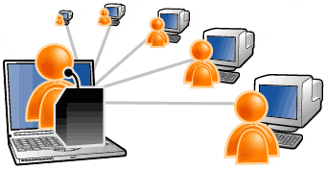
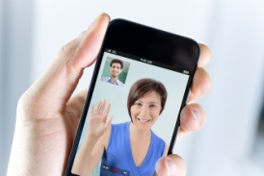
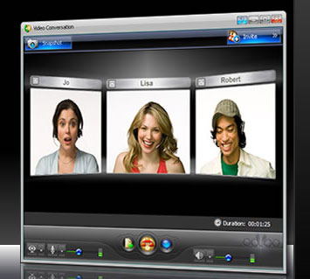
Gateways
In real world Real time video communication is not one to one it will be one to many. SO we need something like a “relay” or ” “bridge” to connect, various users in networks at RTP level. Each such entity will connect streams from different sources and relays the packets without modifying the SSRC, some of them will alter the encoding of data. These entities are some times called Gate Ways or Conference conductors
http://www.cisco.com/c/en/us/products/conferencing/telepresence-conductor/index.html

Slide 18
RTCP
The RTP control protocol (RTCP) is a periodic transmission of control packets to all participants in the session, using the same distribution mechanism as the data packets.
It provides feedback on the quality of the data distribution. Different types of packets are used. It carries a persistent transport-level identifier for an RTP source called the canonical name or CNAME.
SSRC may change from time to time but CNAME remains the same. It is used to identify a participant during the session. RTCP may also contain extra information for the participants like email. By having each participant send its control packets to all the others, each can independently observe the number of participants. This number is used to calculate the rate at which the packets are sent. More users in a session means an individual source may send packets less frequently.

Slide 19
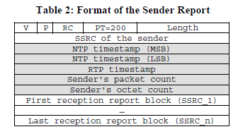
RTCP header
Each RTCP packet starts with an header similar to that of the RTP data packets. The payload type field identifies the type of the packet.
there are five RTCP payload types (200-204) defined:
· Sender Report (SR)
· Receiver Report (RR)
· Source Description (SDES)
· Goodbye (BYE)
· Application-defined packet (APP)

Slide 20
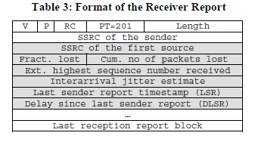
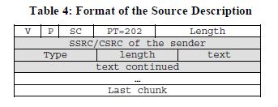

Slide 21
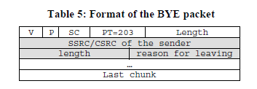

Slide 22
How often RTCP packet need to be transmitted ?
T(n) = t_{(n-1)} + 1 ( Inrement the time by one unit – but that not the way)
Tn = t_{(n-1)} + increment
Tn = T_{(n-1)} + Random Number between (0.5 and 1.5) X MAX(T_{min} and C * Lt_{(n-1)}
Where Tmin = is initially 2.5s and 5s after that, C is a priori calculated interval according to 5% target for the control bandwidth
Lt_{(n-1)} : is the group size estimate of t_{n-1}

